Slide 1
Options 2025-2027
Information for Year 9

Slide 2
The Core Curriculum
All students will study the following in Year 10 & Year 11
English Literature - One GCSE
English Language – One GCSE
Maths – One GCSE
Core P.E (Non examined)
Science (Combined or separate sciences) – Either two or three GCSES
Core RS (Non examined)
PSHE (Non examined)

Slide 3
Options
In addition to the core curriculum students will get to study FOUR options.
One option is a guided option
Three options are free choice
A small group of students will be invited to study Prince’s trust as one of their options (focus on developing confidence and life skills)
On the options form students will choose ONE guided option plus one reserve
Five rank order choices . Three OPEN choices and two reserves
We will try our best to give students their highest rank priority as much as possible however this might not always be possible

Slide 4
One Guided Option
Students must choose one of the following option choices
Geography
History
Spanish
Computer Science
Students may choose more than one of these subjects from this list in Open Options list .
The English Baccalaureate – What is it?

Slide 5
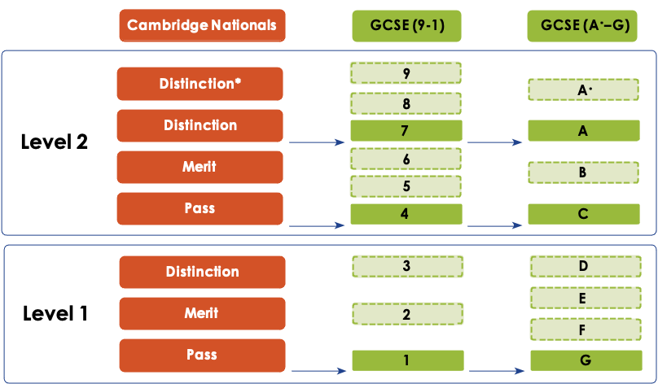
We offer a range of qualifications which prepare students for post 16 study

Slide 6
Three Remaining Options
Students will then study three more choices from the following list
Geography | Exam P.E | Food Technology | Statistics
History | RS | RM | Drama
Computer Science | Art | Graphics | Psychology
Spanish | Music | Health & Social care | Photography
Prince’s Trust * Invite only for a very small group of students
Students can only choose one Technology from Resistant Materials and Graphics as they are the same GCSE course (may choose the other as reserves), Food Technology is a separate subject and may be chosen alongside either RM or Graphics.

Slide 7
To summarise – Students will study
CORE CURRICULUM | GUIDED OPTION | OPEN OPTIONS
All students will study *English *Maths *Science *PSHE *Core RS *Core P.E | One choice from *Spanish *Computer Science *History *Geography | Three choices including any additional GUIDED subjects and any of the OPEN choice subjects

Slide 8
Examples
 | Sarah | Peter
Guided | Spanish | Spanish
Guided Reserve | Geography | History
Open 1 | Art | Health & Social care
Open 2 | History | Art
Open 3 | Geography | Psychology
Open 4 | Photography | Geography
Open 5 | Psychology | P.E

Slide 9
How to make your choices
Consider your strengths and which subjects really interest you
Don’t choose a subject simply because your friends do
Don’t choose a subject because you like the teacher
Be selfish! What do you want?
Take advice from your subject teachers and your form tutor
Find out more about subjects from staff
Ask for help making your decision if you need it
Try and get a good mix of subjects which suit your skills

Slide 10
The process
Forms to be sent out FRIDAY 14TH MARCH by email to main parent contact
Forms must be returned by MONDAY 24th MARCH 9am.
Forms ARE NOT first come first served.
Option Blocks will then be built and students will be informed of their choices approximately by the end of MAY
Mr Mussett and Miss Cooper will be discussing with students if there are any issues.
Reserves WILL be used in some cases so please choose carefully as it is impossible to allocate every student their first four preferences.
If there is not enough interest in a course, then it may not be offered
We withdraw the right to remove subjects from the options process if required

Slide 11
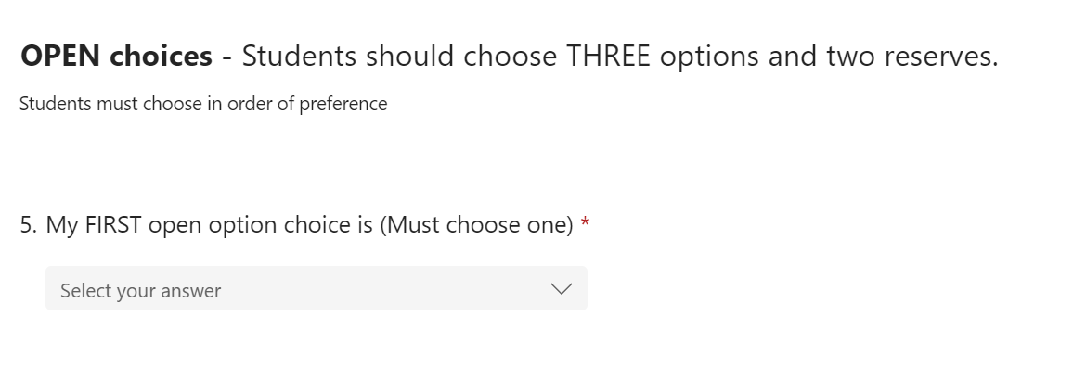
What does the form look like ?
OPEN choices should be chosen in order of preference.
Please do not leave any choices blank
A subject may be selected as a reserve for both GUIDED and OPEN
After you have submitted your choices, you will receive an email response confirming these.

Slide 12
Where can I find the different subjects?
Heartspace | G1 | G10 | Hall | Library
Graphics Food Technology Resistant Materials Art Photography | Maths Statistics English Psychology | Science PE Computer Science | Geography History Religious Studies Spanish | Music Drama Health & Social Care

Slide 13
THANK YOU
Mr Mussett and Miss Cooper will be coming to form groups next week to answer any questions
Staff will be available until 7pm in the Hall, Heartspace, Library, U10 and G1 to discuss the subjects on offer

Slide 14
Subject – English CORE
Who to speak to: - Mrs Gill
English Language- Pearsons Edexcel
What will I learn about?
Plot and context
Theme
Character
How will I be assessed?
Paper 1- Macbeth and An Inspector Calls/ Coram Boy (50%)
Paper 2- Poetry and A Christmas Carol (50%)
English Language- Pearsons Edexcel
What will I learn about?
Analysing language and techniques
Exploring different structural choices
Creative writing
How will I be assessed?
Paper 1- Fiction (50%)
Paper 2- Non Fiction (50%)
Spoken Language

Slide 15
Subject – Maths CORE
Who to speak to: - Mr Hayes
What will I learn?
Topics from the following headings:
Number
Algebra
Ratio and Proportion
Geometry
Statistics and Probability
Course: Edexcel (Pearsons)
How will I be assessed?
Three 1 and ½ hour papers, equally weighted:
Paper 1- Non-calculator
Paper 2- Calculator
Paper 3- Calculator

Slide 16
Subject – Science CORE
Who to speak to: - Mr Jenkins
What will I learn?
You will continue to learn Biology, Chemistry and Physics until the end of Year 11 regardless if you take Triple or Double Science.
The main difference between the two Science courses is there is more content to cover in Triple Science in the same amount of time, so it results in an additional GCSE exam.
Course: AQA
How will I be assessed?
Double Science – 2 GCSE's
Two exams in Biology, Chemistry and Physics each exam is 1 hour 15 minutes
Triple Science – 3 GCSE's
Two exams in Biology, Chemistry and Physics each exam is 1 hour 45 minutes

Slide 17
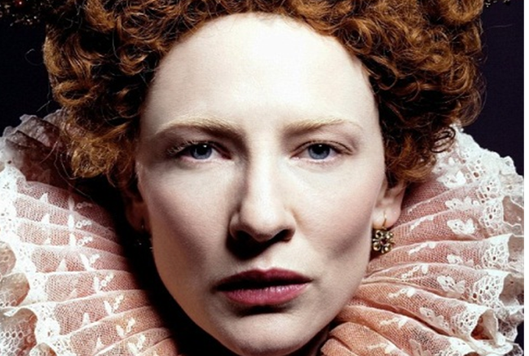
Subject – History
Who to speak to: Miss Terry & Miss Howard
Course: OCR History B (SHP)
What will I learn about?
The USA in Suffolk during WW2
Life inside Nazi Germany
Power & plots in Elizabethan England
Crime & punishments c.1250-today
The birth of the USA: slavery, Native Americans and the American Civil War!
How will I be assessed?
3 exams which assess:
Your ability to analyse sources (photos etc)
Your ability to explain and make connections between events and people.

Slide 18
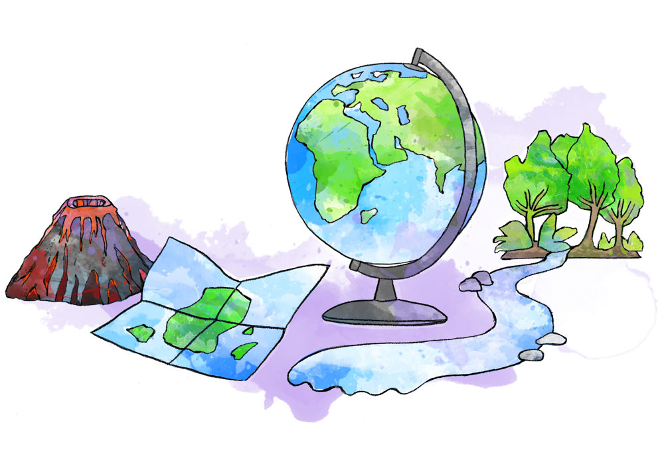
Subject – Geography
Who to speak to: - Mr Craig and Mr Chapman
Course: Edexcel Geography B
What will I learn about?
Hazards, urbanisation and megacities.
UK's coasts, rivers, London and rural areas.
Ecosystems, deforestation and resources.
How will I be assessed?
3 papers of 1 hour 30 minutes.
Mixture of multiple choice, short answer and longer answer questions.

Slide 19
Subject – Spanish
Who to speak to: - Mrs Magowan
Course: Pearson Edexcel, 2024 specification
What will I learn about?
We study Spanish via six Thematic Contexts:
• My personal world
• Lifestyle and wellbeing
• My neighbourhood
• Media and technology
• Studying and my future
• Travel and tourism
How will I be assessed?
There are 4 exams:
Speaking exam 25%
Listening paper 25%
Reading paper 25%
Writing paper 25%
The speaking exam is conducted by your teacher.

Slide 20
Subject – Drama
Who to speak to: - Miss Wright
Course: WJEC Eduqas
What will I learn about?
Acting Techniques
Scripts and skills
Theatre Practitioners
Acting/Lighting/Theatre design and costume
Visit live theatre
How will I be assessed?
A practical controlled assessment working as part of a group
Create an evidence portfolio
Written exam

Slide 21
Subject – Computer Science
Who to speak to: - Mr Lee
Course: OCR J277 Computer Science
What will I learn about?
Systems Architecture
Computational Thinking
Programming
Computer Networks
Ethical Issues and AI
Network Security
Boolean Logic
How will I be assessed?
Exam 1 : Computer Systems
Written Paper
1 hour and 30 minutes
Exam 2 : Computational Thinking and Programming
Written Paper
1 hour and 30 minutes

Slide 22
Subject – Religious Studies
Who to speak to: Mr Livermore/Mrs Chester
Course: Edexcel Religious Studies Spec B
What will I learn about?
Paper one: Religion and Ethics – Christianity
• Christian Beliefs
• Marriage and the Family
• Living the Christian life
• Matters of Life and Death
Paper two: Religion, Peace and Conflict- Islam
• Muslim Beliefs
• Crime and Punishment
• Living the Muslim Life
Peace and conflict
How will I be assessed?
Two written exams at the end of Year 11
Written exam paper 1 – Religion and Ethics Christianity
1 hour 45 minutes
Worth 50% of your final mark
Written exam paper 2 – Religion, peace and conflict – Islam
1 hour 45 minutes
Worth 50% of your final mark

Slide 23
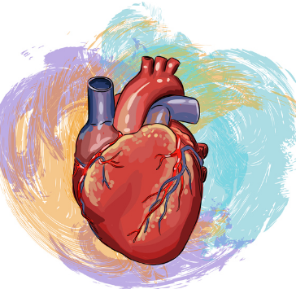
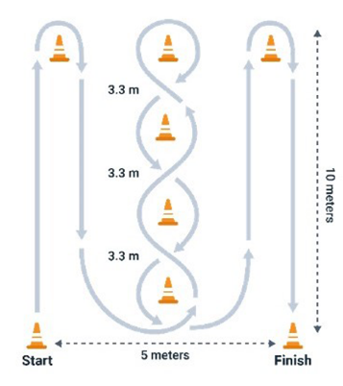
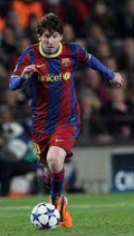
Subject – Sport Science
Who to speak to: - Mr Leppard
Course:
What will I learn about?
Anatomy & Physiology
Fitness training
Fitness testing
Fitness programming
Rules & regulations
National Governing Bodies
Providers of sports facilities
Sports Injuries
Treatment of injuries
Practical Sporting Opportunities
1 x exam (1 hour 15 mins)
2 x internal assessments
5 tasks in 18 hours
Combination of video evidence, written document and PowerPoints

Slide 24
Subject – Art
Who to speak to: - Mrs Mayes
Course: GCSE Art (AQA)
What will I learn about?
You will produce personal sketchbooks in response to a range of themes. These will evidence your creative journey and development of ideas. You will study the work of other artists and analyse their work in detail. The course will enable you to develop your skills in the following areas.
Drawing
Painting
Ceramics
Printing
Mixed media
As part of your personal portfolio, will also produce large-scale drawings, 2D and 3D final pieces.
How will I be assessed?
Unit 1: Personal Portfolio (Year 10) 60% of Total Mark
Unit 2: Externally set exam assignment
10 Hour GCSE Exam (Year 11) 40% of Total Mark
Both units must show evidence for all ASSESSMENT OBJECTIVES
AO1 Develop ideas
AO2 Explore
AO3 Record ideas
AO4 Produce a personal response

Slide 25
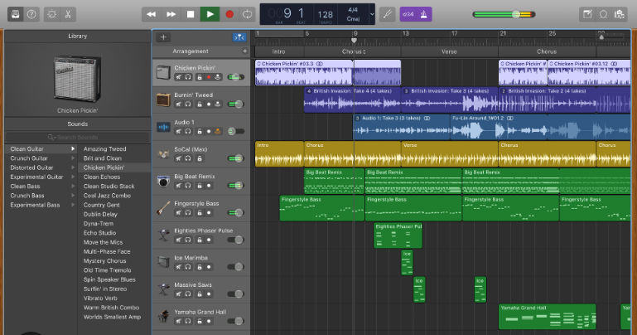
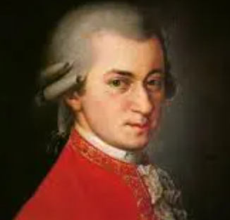
Subject – Music
Who to speak to: Mrs Hutchinson
Course: OCR GCSE Music
What will I learn about?
5 Areas of Study:
AOS1 – My instrument
Learn to play pieces on your instrument of choice or develop your Music Technology skills and use recording and producing software
AOS2 – The Classical Concerto
Learn about Baroque, Classical and Romantic Music
AOS3 – World Music
Study Greek, Palestinian, African, South American, Indian and Punjab Music
AOS4 – Film and Game Music
Study film scores and music used in Computer Games
AOS5 – Popular Music
Learn about Rock and Roll from the 50's and 60's, Rock Anthems from the 70's and 80's, Pop Ballads from the 70's, 80's and 90's and Solo Pop Artists from 90's to present day.
How will I be assessed?
90 Minute Listening Exam – 40%
1 Solo performance – 15%
recorded on an instrument of your choice (or piece recreated on music software)
1 Free Choice Composition – 15%
Write your own piece of music completely made up by you!
1 Ensemble Performance – 15%
recorded on an instrument of your choice with at least one other person (or piece recreated on music software)
1 Brief Choice Composition – 15%
Write your own piece of music completely made up by you but in response to a set of instructions given to us by the exam board e.g. write a piece for a new film being released about an alien invasion...

Slide 26
Subject – Photography
Who to speak to: - Mrs Mayes
Course: GCSE Photography (AQA)
How will I be assessed?
What will I learn about?
You will produce a digital portfolio in response to a range of themes. You will evidence your photographic journey and development of ideas. You will study the work of other photographers and analyse their work in detail. In lessons, you will plan your photoshoots, which you will photograph as homework tasks in your chosen locations. The course will enable you to develop your skills using Photoshop to digitally manipulate and enhance your photos.
You will be required to demonstrate skills in all of the following:
the ability to explore elements of visual language, line, form, colour, pattern and texture in the context of photography
awareness of intended audience or purpose for their chosen area(s) of photography
the ability to respond to an issue, theme, concept or idea, or work to a brief or answer a need in photography
appreciation of viewpoint, composition, aperture, depth of field, shutter speed and movement
appropriate use of the camera, film, lenses, filters and lighting for work in their chosen area(s) of photography
understanding of techniques related to the production of photographic images and, where appropriate, presentation and layout.
How will I be assessed?
Unit 1: Personal Portfolio (Year 10) 60% of Total Mark
Unit 2: Externally set exam assignment
10 Hour GCSE Exam (Year 11) 40% of Total Mark
Both units must show evidence for all ASSESSMENT OBJECTIVES
AO1 Develop ideas
AO2 Explore
AO3 Record ideas
AO4 Produce a personal response

Slide 27
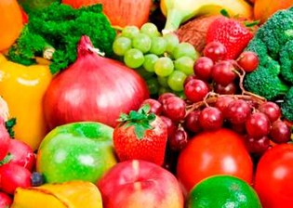
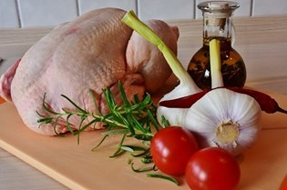
Subject – Food Technology
Who to speak to: - Mrs Iannone
Course:
Food Preparation & Nutrition.
What will I learn about?
Food commodities
Principles of nutrition
Diet and good health
The science of food
Where food comes from
Cooking and food preparation
How will I be assessed?
Component 1-Principles of food preparation and nutrition
Written examination =50% of qualification
Component 2-Food preparation and nutrition in action
Two-NEA(Non examination assessments) Practical and written =50% of qualification

Slide 28
Subject – Resistant Materials
Who to speak to: - Mr Coe & Mr Stephens
What will I learn about?
How to develop realistic design proposals as a result of the exploration of design opportunities and users’ needs, wants and values
The generation of imaginative ideas when designing.
How to critique and refine their own ideas whilst designing and making.
Communicating design ideas and decisions using different media and techniques, as appropriate for different audiences at key points in their designing.
Developing decision making skills, including the planning and organisation of time and resources when managing their own project work
Developing a broad knowledge of materials, components and technologies and practical skills to develop high quality, imaginative and functional prototypes.
How to be ambitious and open to explore and take design risks in order to stretch the development of design proposals, avoiding clichéd or stereotypical responses
Costs, commercial viability and marketing of products.
Safe working practices in design and technology
Use of key design and technology terminology including those related to: designing, innovation and communication; materials and technologies; making, manufacture and production; critiquing, values and ethics.
Course: AQA
How will I be assessed?
Written exam Paper, 2hours – Marked out of 100 and worth 50% of GCSE award. Taken at the end of Year 11 and marked externally.
· Section A – Core technical principles (20 marks). A mixture of multiple choice and short questions assessing general Technology knowledge.
· Section B – Specialist technical principles (30 marks). Questions based around students selected specialism, several short answer question and one extended response to assess more in depth knowledge.
· Section C – Designing and making principles (50 marks). A mix of short and long answer questions.
Non-Exam Assessment - Portfolio based design and make task, marked out of 100 and worth 50% of GCSE award. Marked by teachers then externally moderated by exam board, started at the end of Year 10

Slide 29
Subject – Graphics
Who to speak to: - Mr Coe & Mr Stephens
What will I learn about?
How to develop realistic design proposals as a result of the exploration of design opportunities and users’ needs, wants and values
The generation of imaginative ideas when designing.
How to critique and refine their own ideas whilst designing and making.
Communicating design ideas and decisions using different media and techniques, as appropriate for different audiences at key points in their designing.
Developing decision making skills, including the planning and organisation of time and resources when managing their own project work
Developing a broad knowledge of materials, components and technologies and practical skills to develop high quality, imaginative and functional prototypes.
How to be ambitious and open to explore and take design risks in order to stretch the development of design proposals, avoiding clichéd or stereotypical responses
Costs, commercial viability and marketing of products.
Safe working practices in design and technology
Use of key design and technology terminology including those related to: designing, innovation and communication; materials and technologies; making, manufacture and production; critiquing, values and ethics.
Course: AQA
How will I be assessed?
Written exam Paper, 2hours – Marked out of 100 and worth 50% of GCSE award. Taken at the end of Year 11 and marked externally.
· Section A – Core technical principles (20 marks). A mixture of multiple choice and short questions assessing general Technology knowledge.
· Section B – Specialist technical principles (30 marks). Questions based around students selected specialism, several short answer question and one extended response to assess more in depth knowledge.
· Section C – Designing and making principles (50 marks). A mix of short and long answer questions.
Non-Exam Assessment - Portfolio based design and make task, marked out of 100 and worth 50% of GCSE award. Marked by teachers then externally moderated by exam board, started at the end of Year 10

Slide 30
Subject – Health & Social Care
Who to speak to: - Mrs Jamieson
Course: Cambridge National in Health and Social care (Levels 1 & 2)
What will I learn about?
Health and Social Care develops real world skills through the use of case studies to plan and analyse individual care. This is a vocational course ideal for students that are considering a career in the Health and Social Care sector. Examples of careers that students may wish to pursue include nursing, midwifery, counselling, psychology, care work, speech and language therapy and special educational needs teaching.
Students are encouraged to develop industry specific knowledge and skills and apply them to practical situations by completing coursework / NEA’s in the form of written reports as well as undertaking examinations in some units.
Various topics are covered including human growth and life stages. You will develop skills that can be used in other life and work situations, such as Communicating effectively with individuals or groups. Communication is at the heart of health and social care and is taught or applied in all units.
How will I be assessed?
Students are assessed across 3 components:
RO32 Principles of care in health and social care settings – External examination. This exam makes up 40% of the final grade.
2) RO33 Supporting individuals through life events – NEA (Non-Examined Assessment)
3) RO34 Creative and therapeutic activities OR RO35 Health promotion campaigns – NEA (Non-Examined Assessment)
The NEA components completed through coursework make up 30% each of the final grade.

Slide 31
Subject – Psychology
Who to speak to: - Mr Mussett & Mr Sims
Course: AQA GCSE Psychology 8182
What will I learn about?
Unit 1 – Memory
Unit 2 - Perception
Unit 3 - Development
Unit 4 - Research Methods
Unit 5 - Social Influence
Unit 6 - Language, Thought & Communication
Unit 7 - The Brain & Neuropsychology
Unit 8 - Psychological Problems
How will I be assessed?
Paper 1 : Cognition & Behaviour
Written exam (Units 1-4)
100 marks
1 hour and 45 minutes
Each unit – multiple choice, short answer & extended writing (25 marks)
Paper 2 : Social Context & Behaviour
Written exam (Units 5-8)
100 marks
1 hour and 45 minutes
Each unit – multiple choice, short answer & extended writing (25 marks)

Slide 32
Subject – Statistics
Who to speak to: - Mr Hayes
What will I learn about?
Planning and data collection
Processing, representing and analysing data
Reasoning, interpreting and discussing results
Probability
Course: Edexcel (Pearsons)
How will I be assessed?
Two 1 and ½ hour papers, equally weighted:
Paper 1- Calculator
Paper 2- Calculator

